Slide 1

Walmart Sales Demand Forecasting
M5 Competition Dataset Analysis
Advanced Time Series Forecasting using Machine Learning and Deep Learning Approaches for Multi-Level Hierarchical Retail Data

Slide 2

Abstract & Introduction
Problem Statement
Accurate demand forecasting is critical for retail operations, impacting inventory management, supply chain optimization, and revenue maximization. Traditional methods struggle with complex, multi-dimensional retail data.
Dataset Overview: M5 Competition
Scale: 30,490 products across 10 Walmart stores in 3 states (CA, TX, WI)
Time Period: 1,969 days of historical sales data (2011-2016)
Hierarchical Structure: Product → Category → Department → Store → State
Additional Features: Calendar events, SNAP benefits, price variations, promotions
Project Significance
This project addresses real-world retail challenges by developing robust forecasting models that handle:
High-dimensional time series data with multiple hierarchical levels
External factors like holidays, events, and economic indicators
Intermittent demand patterns and zero-inflation

Slide 3
Literature Review
Traditional Statistical Methods:
ARIMA & SARIMA: Widely used for univariate time series; capture trends and seasonality but struggle with multivariate dependencies
Exponential Smoothing (ETS): Effective for simple seasonal patterns; limited in handling complex external variables
Prophet (Facebook): Handles seasonality and holidays well; lacks deep pattern recognition for hierarchical data
Machine Learning Approaches:
Random Forest & XGBoost: Strong performance with feature engineering; require extensive manual feature creation
LightGBM: Used by M5 competition winners; excellent with tabular data and categorical features
Support Vector Regression (SVR): Handles non-linear relationships; computationally expensive for large datasets
Deep Learning Methods:
LSTM & GRU Networks: Capture long-term temporal dependencies; proven effective in retail forecasting
Temporal Convolutional Networks (TCN): Efficient parallel processing; good for long sequences
Transformer Models: Attention mechanisms for complex patterns; computationally intensive
N-BEATS: Pure deep learning approach without feature engineering; interpretable architecture

Slide 4

Gaps & Limitations in Existing Research
❌ Scalability Issues
Most models struggle with 30,000+ products simultaneously. Hierarchical forecasting approaches are computationally prohibitive at scale.
❌ Feature Engineering Burden
Traditional ML requires extensive manual feature creation. Lag features, rolling statistics, and encodings need domain expertise.
❌ Intermittent Demand Handling
Many products have zero sales on multiple days. Standard loss functions fail to address zero-inflated distributions effectively.
❌ Hierarchy Reconciliation
Bottom-up and top-down forecasts often disagree. Ensuring coherent predictions across aggregation levels remains challenging.
❌ Temporal Dependencies
Statistical methods miss complex interactions between time steps. Simple models cannot capture promotional effects that span multiple weeks.
❌ Model Interpretability
Deep learning models act as black boxes. Retail stakeholders need explainable predictions for business decisions.
Key Research Gap
No single approach effectively balances accuracy, scalability, interpretability, and handling of hierarchical retail data with intermittent demand patterns.

Slide 5
Research Objectives
Primary Objective
Develop and compare multiple forecasting approaches for accurate, scalable demand prediction across Walmart's hierarchical product structure while addressing zero-inflated sales patterns.
Specific Goals
Build Robust Baseline Models: Implement traditional statistical methods (ARIMA, Prophet) to establish performance benchmarks
Develop ML-Based Forecasters: Create ensemble models (XGBoost, LightGBM, Random Forest) with optimized feature engineering pipelines
Implement Deep Learning Architectures: Design and train LSTM/GRU networks, TCN, and hybrid models for sequential pattern learning
Handle Hierarchical Reconciliation: Apply bottom-up and top-down forecasting strategies with coherent aggregation methods
Address Intermittent Demand: Incorporate specialized loss functions and probabilistic forecasting for zero-inflated sales
Optimize Evaluation Metrics: Use WRMSSE (Weighted Root Mean Squared Scaled Error) aligned with M5 competition standards
Deploy Scalable Solution: Create an efficient pipeline capable of generating forecasts for 30,000+ time series

Slide 6
Contribution & Module Architecture
Module 1: Data Preprocessing & Feature Engineering
Handles missing values, categorical encoding, lag features (7/14/28 days), rolling statistics, and calendar features
Module 2: Statistical Baseline Models
ARIMA, SARIMA, Prophet for baseline performance and seasonal pattern analysis
Module 3: Gradient Boosting Ensemble
XGBoost, LightGBM, CatBoost with hyperparameter optimization and feature importance
Module 4: Deep Learning Time Series
LSTM/GRU networks with attention mechanisms for temporal dependencies

Slide 7
Contribution & Module Architecture
Module 5: Hierarchical Forecasting Engine
Bottom-up and top-down reconciliation ensuring coherent multi-level predictions
Module 6: Zero-Inflation Handler
Tweedie loss function and probabilistic forecasting for intermittent demand
Module 7: Evaluation Framework
WRMSSE, RMSE, MAE metrics with cross-validation across hierarchies
Module 8: Visualization Dashboard
Interactive reports with forecast comparisons and performance analytics

Slide 8
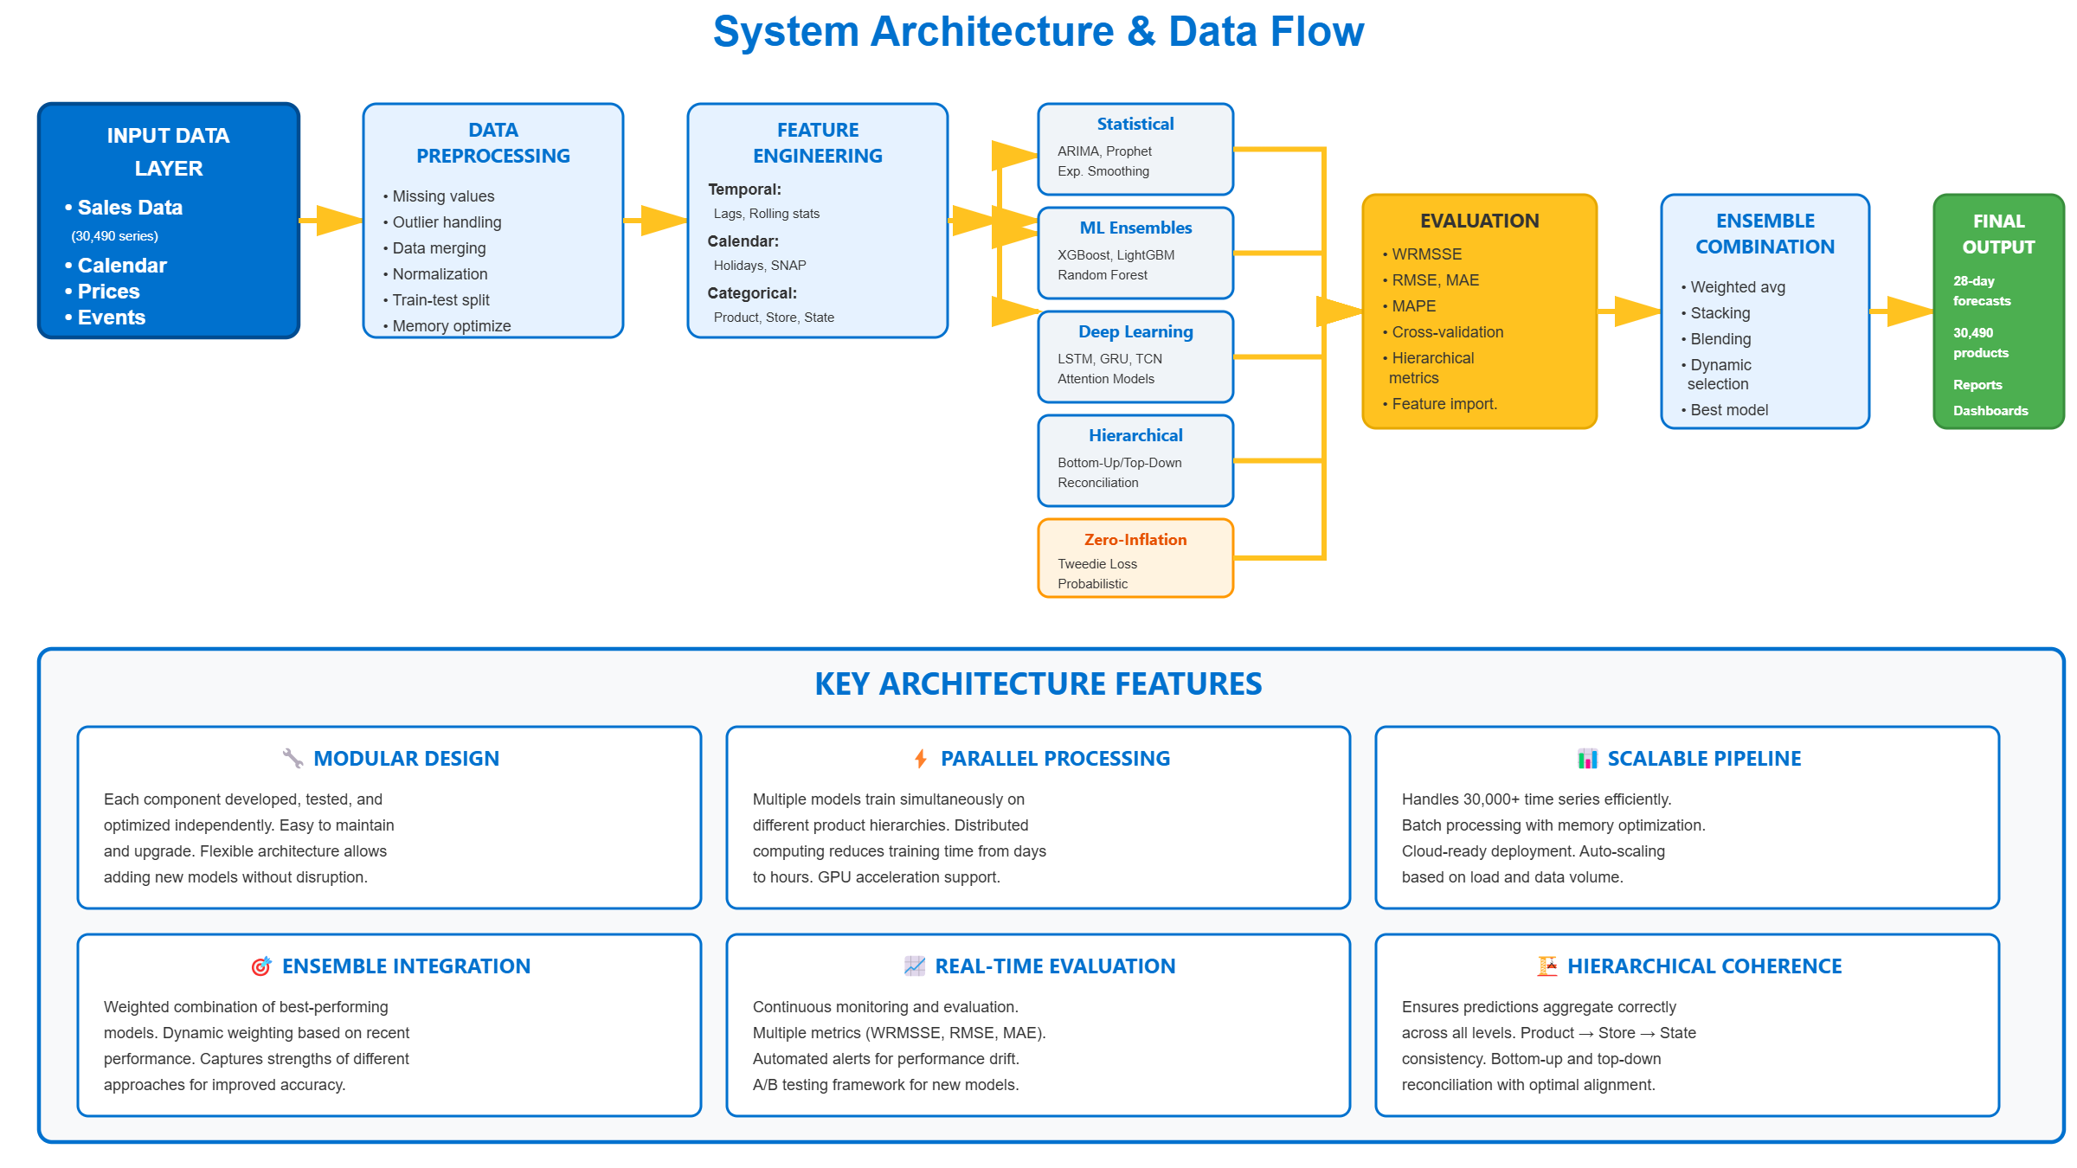
Architecture

Slide 9

THANK YOU!!!

